Slide 1
Section 8.1
The Inverse Sine, Cosine, and Tangent Functions
Copyright © 2012 Pearson Education, Inc. Publishing as Prentice Hall.

Slide 2
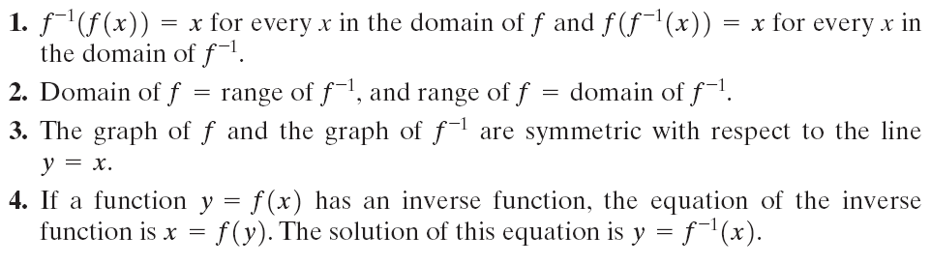
Review of Properties of Functions and Their Inverses
Copyright © 2012 Pearson Education, Inc. Publishing as Prentice Hall.

Slide 3
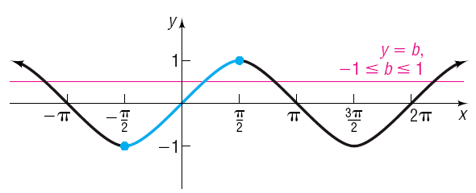
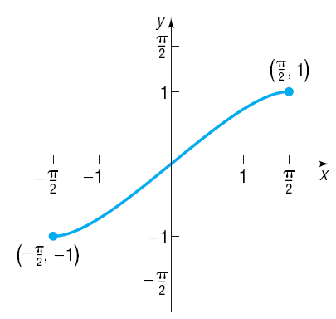

Copyright © 2012 Pearson Education, Inc. Publishing as Prentice Hall.

Slide 4
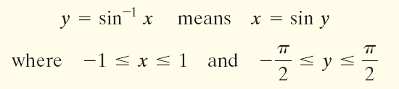
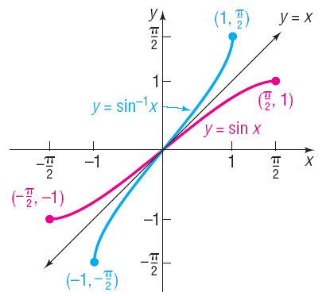

Copyright © 2012 Pearson Education, Inc. Publishing as Prentice Hall.

Slide 5
Copyright © 2012 Pearson Education, Inc. Publishing as Prentice Hall.

Slide 6


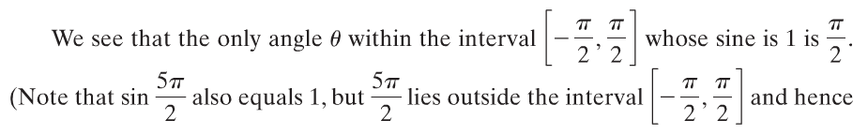
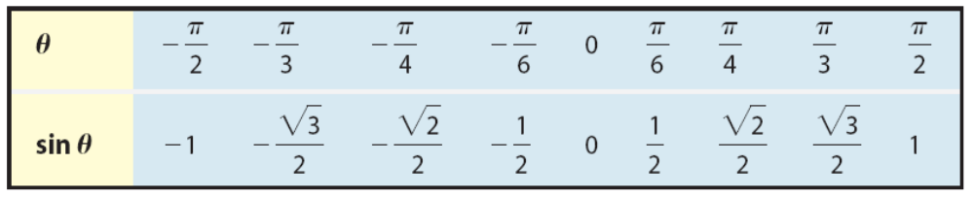
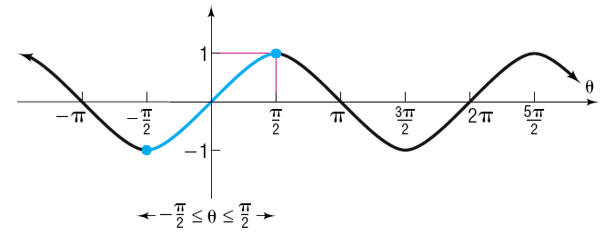
Copyright © 2012 Pearson Education, Inc. Publishing as Prentice Hall.

Slide 7


Copyright © 2012 Pearson Education, Inc. Publishing as Prentice Hall.

Slide 8
Copyright © 2012 Pearson Education, Inc. Publishing as Prentice Hall.

Slide 9
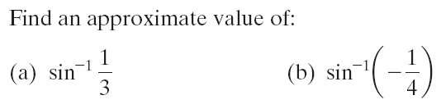
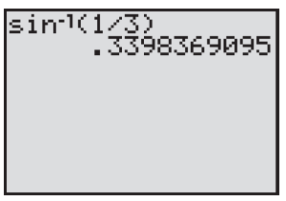
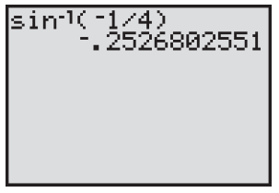
Copyright © 2012 Pearson Education, Inc. Publishing as Prentice Hall.

Slide 10
Copyright © 2012 Pearson Education, Inc. Publishing as Prentice Hall.

Slide 11

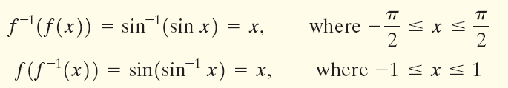
Copyright © 2012 Pearson Education, Inc. Publishing as Prentice Hall.

Slide 12
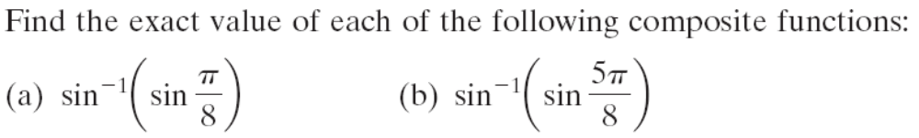


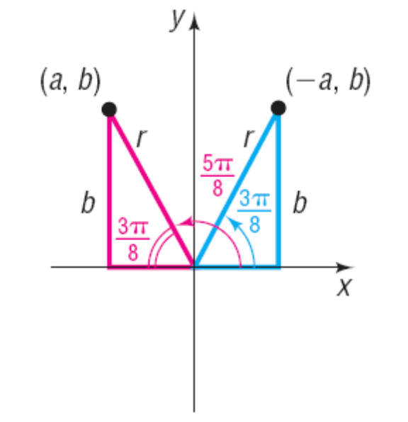
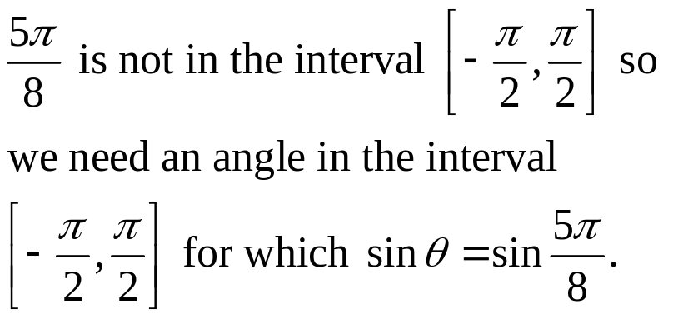

Copyright © 2012 Pearson Education, Inc. Publishing as Prentice Hall.

Slide 13
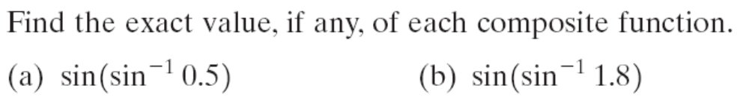
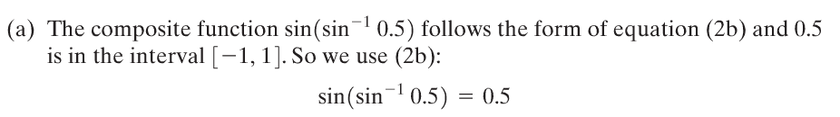

Copyright © 2012 Pearson Education, Inc. Publishing as Prentice Hall.

Slide 14
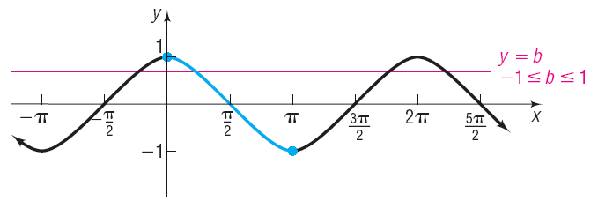

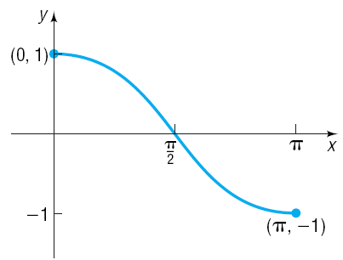
Copyright © 2012 Pearson Education, Inc. Publishing as Prentice Hall.

Slide 15
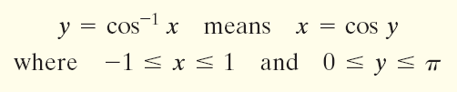
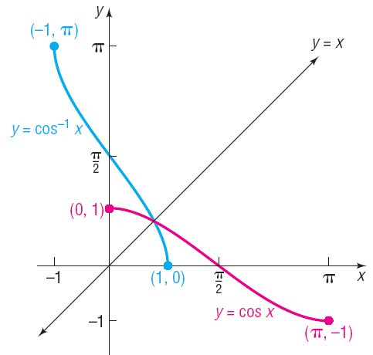

Copyright © 2012 Pearson Education, Inc. Publishing as Prentice Hall.

Slide 16

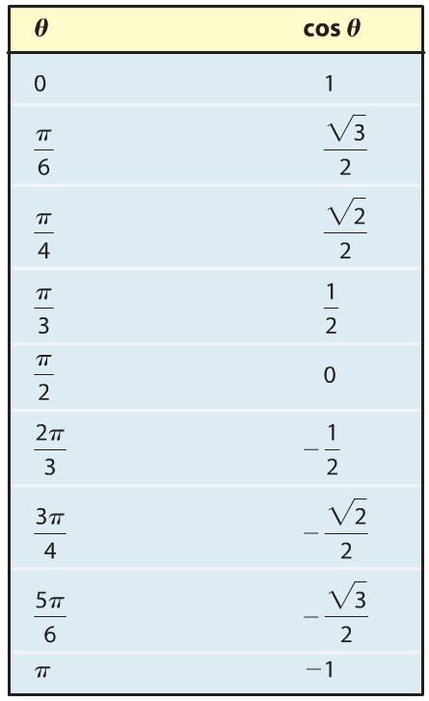

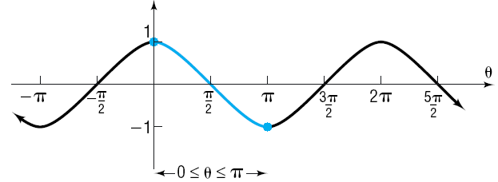
Copyright © 2012 Pearson Education, Inc. Publishing as Prentice Hall.

Slide 17

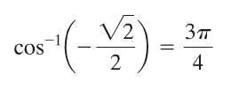
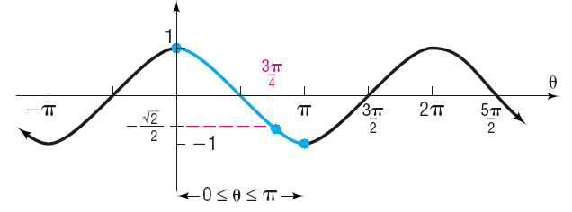
Copyright © 2012 Pearson Education, Inc. Publishing as Prentice Hall.

Slide 18
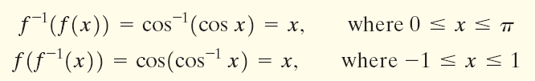
Copyright © 2012 Pearson Education, Inc. Publishing as Prentice Hall.

Slide 19
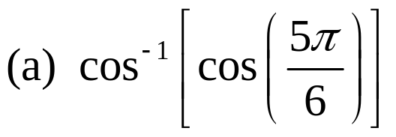
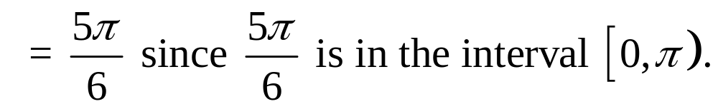
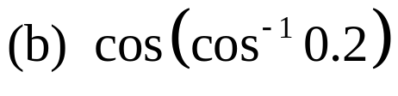
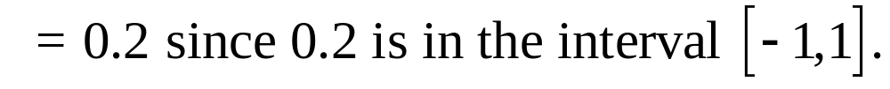
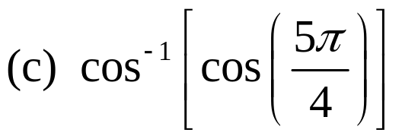
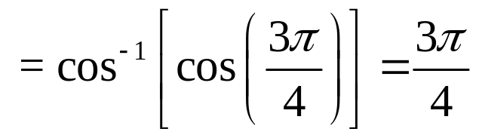
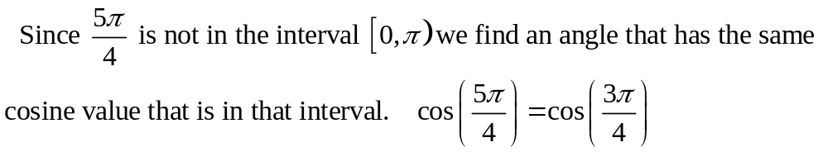
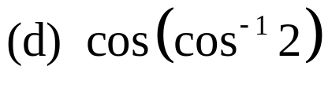
Copyright © 2012 Pearson Education, Inc. Publishing as Prentice Hall.

Slide 20
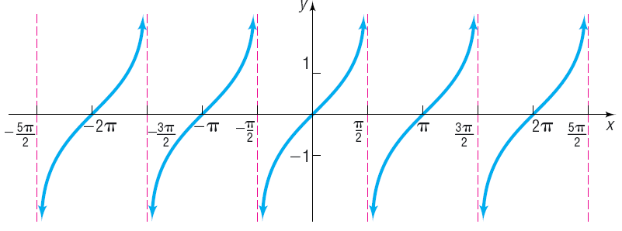

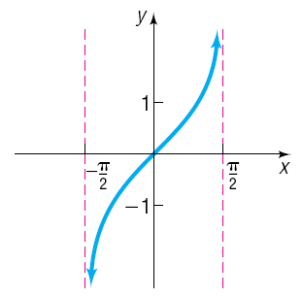
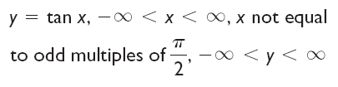
Copyright © 2012 Pearson Education, Inc. Publishing as Prentice Hall.

Slide 21
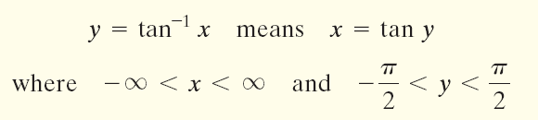
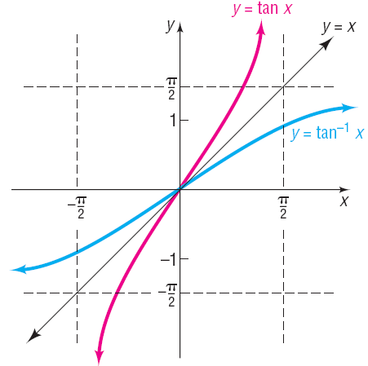
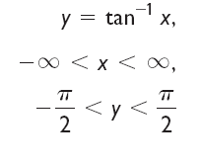
Copyright © 2012 Pearson Education, Inc. Publishing as Prentice Hall.

Slide 22

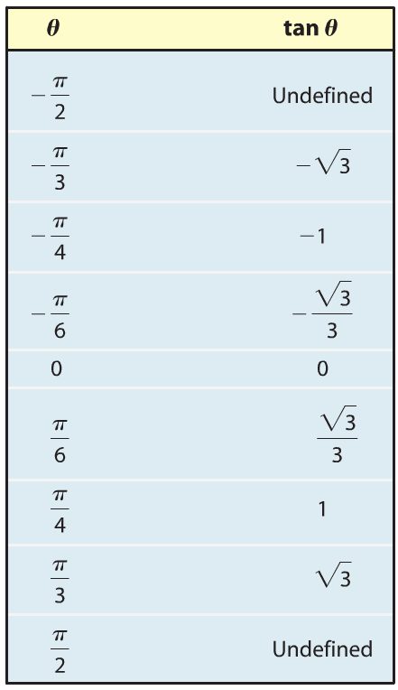


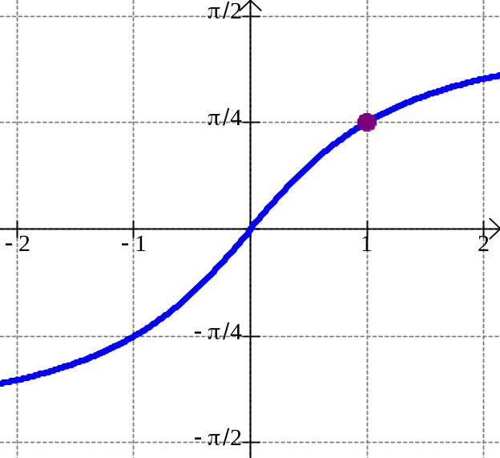

Copyright © 2012 Pearson Education, Inc. Publishing as Prentice Hall.

Slide 23


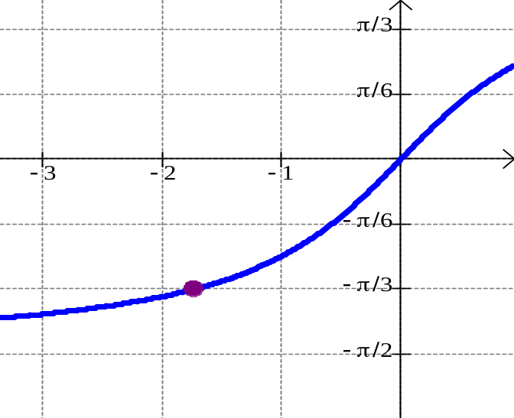


Copyright © 2012 Pearson Education, Inc. Publishing as Prentice Hall.

Slide 24
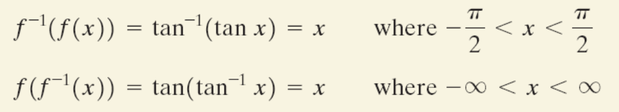
Copyright © 2012 Pearson Education, Inc. Publishing as Prentice Hall.

Slide 25
Copyright © 2012 Pearson Education, Inc. Publishing as Prentice Hall.

Slide 26
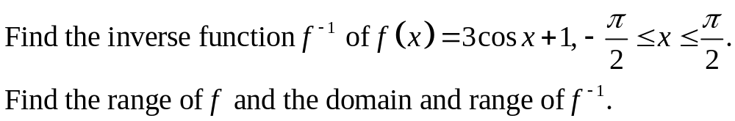



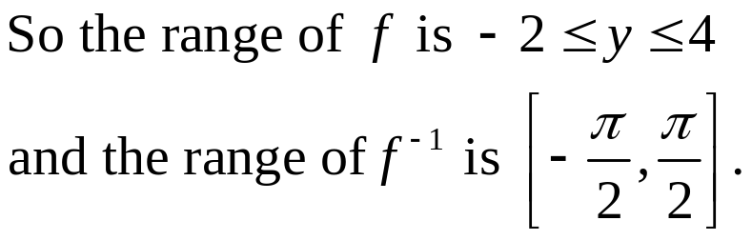
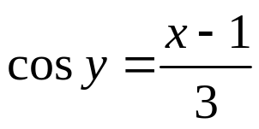
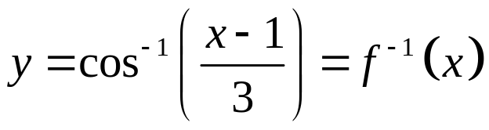
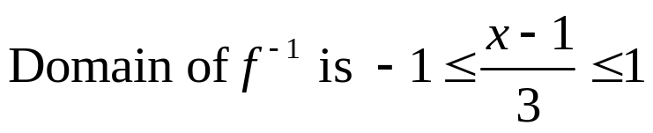


Recall that the domain of f is the range of f⁻¹ and the range of f is the domain of f⁻¹.
interchange x and y
Copyright © 2012 Pearson Education, Inc. Publishing as Prentice Hall.

Slide 27
Copyright © 2012 Pearson Education, Inc. Publishing as Prentice Hall.

Slide 28
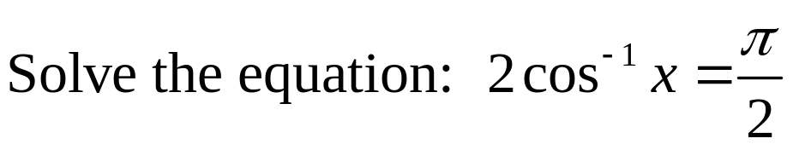



Copyright © 2012 Pearson Education, Inc. Publishing as Prentice Hall.

